Slide 1
DATA PROFESSIONAL
STANLEY KWADZO OVULLEY

Slide 2
About the Data
This data was gathered by Alex Freberg popularly known on YouTube as Alex the Analyst. He is Analytics Manager working directly with stakeholders to help them better manage and utilize their data. I specialize in SQL, Python, and Cloud Applications.
The data provide certain information about professionals in the Data Industry: Data Analyst, Data Architect, Data Engineer, Data Scientist, Database Developer, Student and Other.
Areas such as age, income , favorite programming language were looked at.
It important to note that a Questionnaire was used to gather the data.

Slide 3
KEYs IN THE QUESTIONNAIRE
Difficulty : How difficult was it for you to break into Data?
AnotherWork: If you were to look for a new job today, what would be the most important thing to you?
Questions on Happiness
Q6A : How Happy are you in your Current Position with the following? (Salary)
Q6B : How Happy are you in your Current Position with the following? (Work/Life Balance)
Q6C: How Happy are you in your Current Position with the following? (Coworkers)
Q6D: How Happy are you in your Current Position with the following? (Management)
Q6E : How Happy are you in your Current Position with the following? (Upward Mobility)
Q6F : How Happy are you in your Current Position with the following? (Learning New Things)

Slide 4
DATA CLEANING
Packages use for this work includes: dplyr, tidyverse, ggplot, likert
Columns such as JobTitle, Industry, FavoriteLanguage, Difficulty, AnotherWork were split using some delimiters depending on the column in order to get standardize the options in these columns to make analysis easier. This was done using the “Seperator” function.
The Income Columns in the data was give in ranges. The Income Column was then splited into two coleus and the average of these two column was used to as the Salary for the various professionals.
Check for missing values was only done when the columns useful for the analysis were selected. The missing values were then remove because they were 36.
Columns selected are: JobTitle., Industry, FavoriteLanguage, Gender, Income, Difficulty, AnotherWork, Current.Age, Q6, Q7, Q8, Q9, Q10, Q11.
Some selected variables were the factorize to in the analysis.

Slide 5
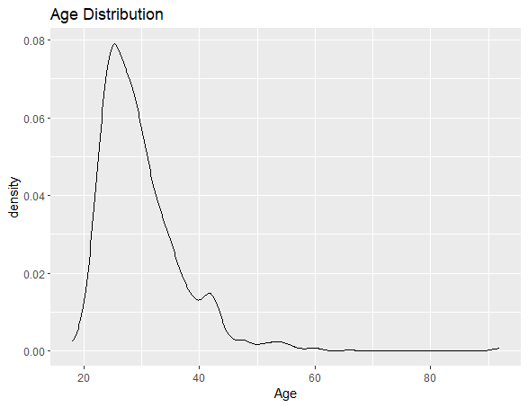
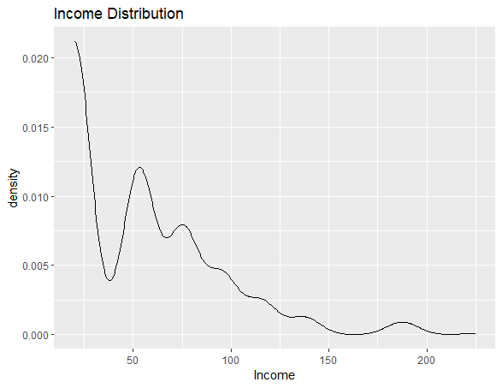
AGE AND INCOME DISTRIBUTION
The average age is around 30 , the minimum is 18 and the maximum age is 92.
The distribution shows that Majority of the respondents are withing the 20 to 40 age group.
The average income according to the analysis shows the according minimum salary is $20 and the maximum Salary is $225

Slide 6
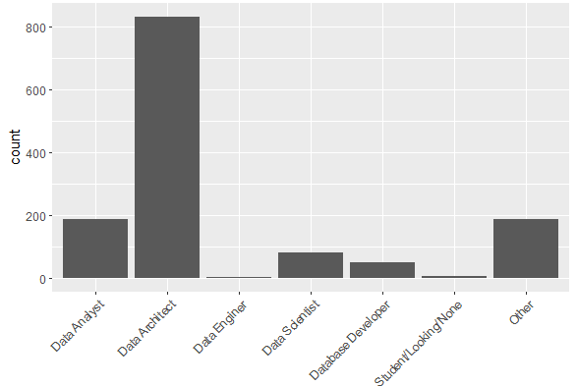
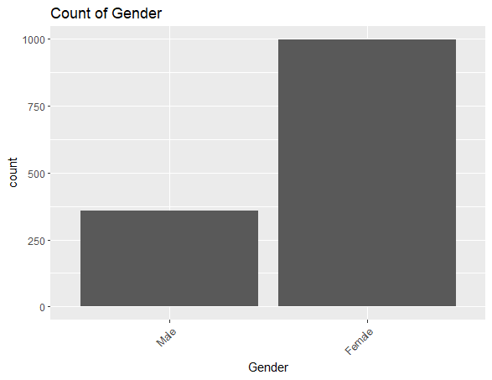
Bar Chart Using Various Count
This shows a count by Gender.
In important to note that this questionnaire got a lot of female respondents as the graph shows.
This shows count of the various data professionals
Among the professions, Data Arhitects have the greater number of respondents followed closely by Data Analyst and people who selected the other option.

Slide 7
Count of Females in the Industries
Count of Python and R Users
JobTitle | Python | R
Data Analyst | 28 | 114
Data Architect | 134 | 545
Data Enginer | 0 | 5
Data Scientist | 10 | 60
Database Developer | 2 | 43
Student/Looking/None | 4 | 4
Other | 23 | 119
JobTitle | Females
Data Analyst | 132
Data Architect | 599
Data Enginer | 3
Data Scientist | 73
Database Developer | 47
Student/Looking/None | 7
Other | 135
Count Python and R Users in the Industries
Count of Females in the Industries
Industry | Python | R
Agriculture | 70 | 278
Construction | 6 | 6
Education | 8 | 15
Finance | 11 | 47
Healthcare | 36 | 152
Real Estate | 36 | 108
Tech | 3 | 16
Telcommunication | 22 | 237
Other | 29 | 31
Industry | Females
Agriculture | 345
Construction | 7
Education | 21
Finance | 55
Healthcare | 151
Real Estate | 118
Tech | 20
Telcommunication | 237
Other | 42

Slide 8
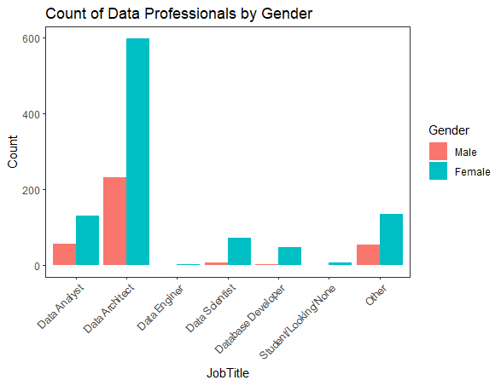
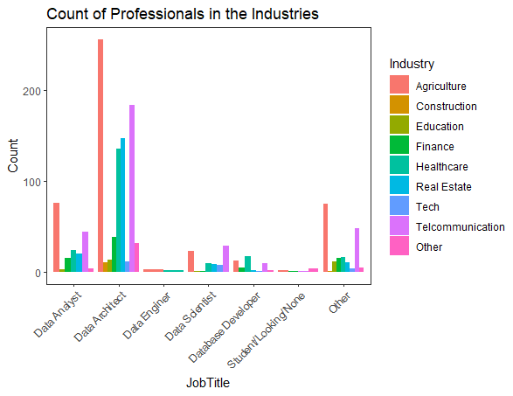
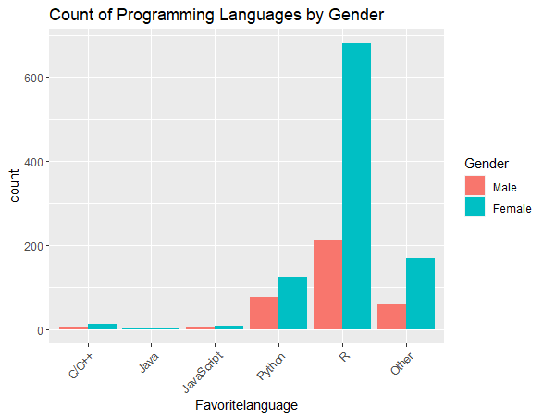
These graphs shows various count and this incluse Count by Professionals by gender, Count of Professionals who are in the various industries and Count of programing languages by Gender.
The Data seems to have a lot of female respeondents which shows how a lot oof females are developing interest in the area of work.
The result also suggest that the agriculture industry is also take advantage of the capabilities of managing and using data as many respondents were gotten from that sector.

Slide 9


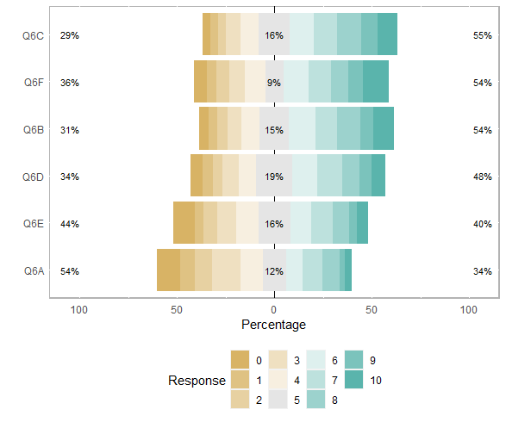

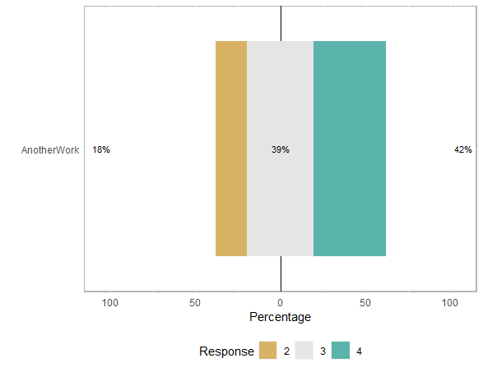
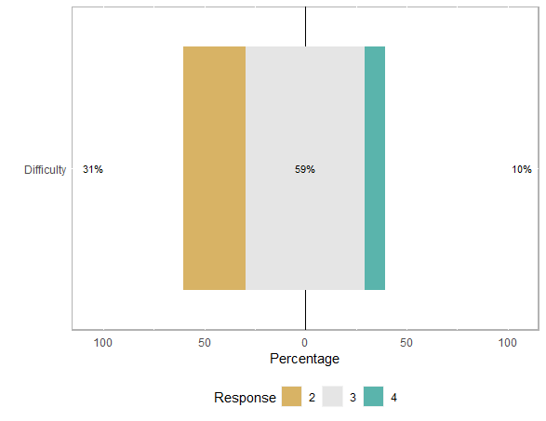
RESULTS ON THE QUESTIONS ON HAPPINESS , LEVEL OF DIFFICULTY
AND FATORS THAT WOULD INFLUENCE SERACH FOR ANOTHER JOB
z
A scale of 0-10 was used for the Question on Happiness where 0-Not Happy and 10- Extremely Happy.
Question concerning the level Difficulty use a Scale 1 to 5 where 1-Difficult, 2-Easy, 3-Neither easy nor difficult, 4-Very Difficult, 5-Very Easy
Question on Another Work used a scale of 1-5 where
1-Better Salary, 2-Good Culture, 3-Good Work/Life Balance, 4-Remote Work. 5- others
The response on the Question regarding Difficulty suggest that most of these respondents found it quite easy breaking through the Data Industry
The response on the question regarding Another Work also suggest that Majority of the respondents Look at out for work/Life Balance when moving to another job

Slide 10
CONCLUSION
One observation that one can draw from this analysis is the interest
Of the young generation in this industry. This shows the industry as
a whole is having a future and is here to stay.
The importance of data and it usage to solve organizational problem
is being realize by most individuals and industries.
The view that the Data Industry is Male dominated may not be entirely true
as the dominated analysis suggests that Females are taking various role and are
largely involve in this industry.
This also go to prove that the Sector is Gender friendly and open to all.
Money (Salary) is not the only factor people consider before moving to another job
as the data shows that people consider order factors such as good work life / Life Balance.

Slide 11
REFERENCES
(6) Likert scale in #R #software #sokora – YouTube
(6) How to recode likert scale data in R - YouTube
(6) How to Split a Column into Multiple Columns in R. [HD] – YouTube
(6) Alex The Analyst - YouTube

